Slide 1


Ansible for Real-World IT Ops: Introduction
Automating IT operations for efficient infrastructure management
Content:
Introduction
Reason to Use Ansible
Ansible Concept
Ansible Inventory
Demo – Writing a very simple Playbook
Notes:
---

Slide 2
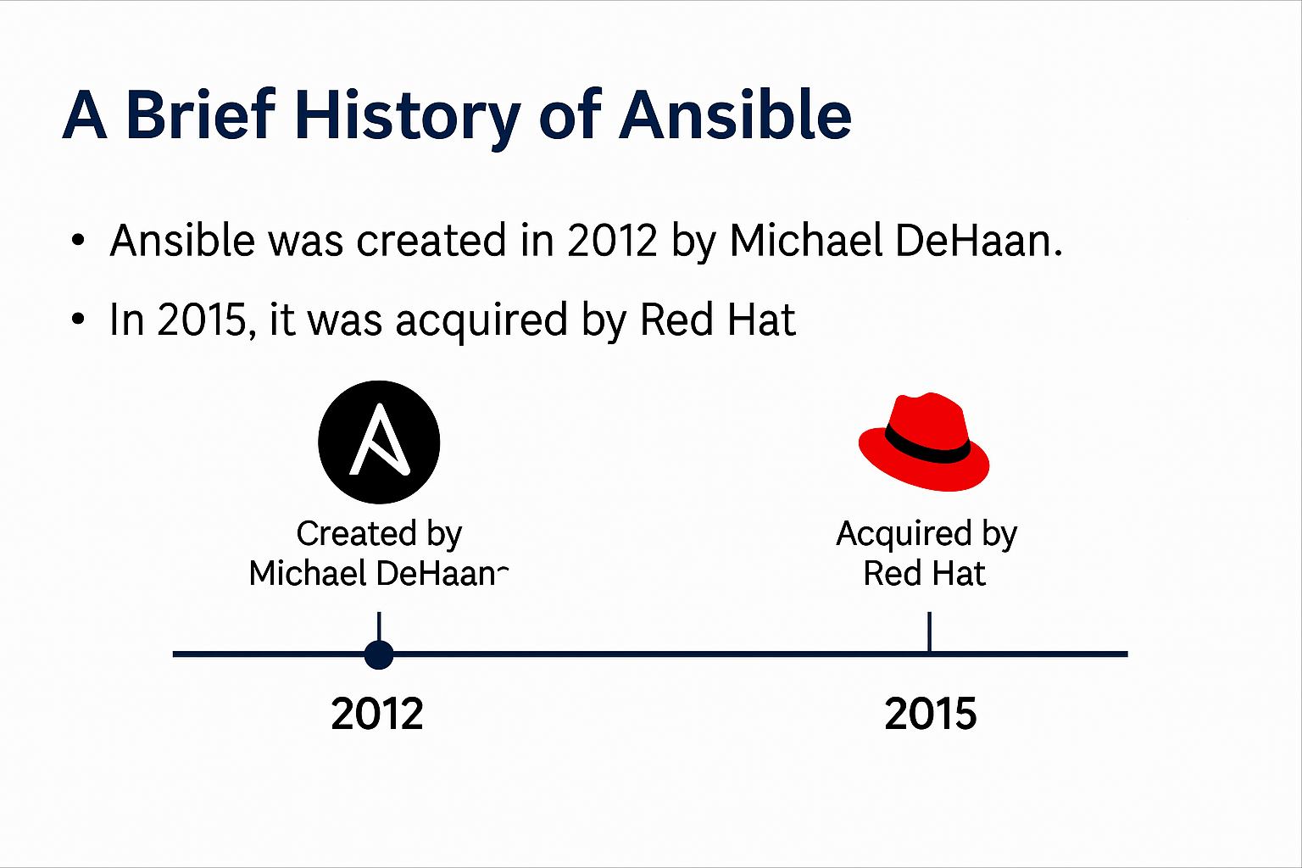
Brief history of Ansible
- Ansible was created by Michael DeHaan in 2012.
- It was designed to simplify automation using SSH and YAML.
- Ansible quickly gained popularity for its agentless architecture.
- In 2015, Red Hat acquired Ansible to strengthen its automation portfolio.
- Today, Ansible is widely used in DevOps, cloud provisioning, and configuration management.

Slide 3
Introduction to Ansible – Summary
Ansible is an open-source automation tool that simplifies complex IT tasks and works across diverse environments. It enables automation for:
Eliminating repetitive tasks and simplifying workflows
Managing and maintaining system configurations
Deploying complex software continuously
Performing zero-downtime rolling updates
Ansible uses human-readable YAML playbooks to define the desired state of systems, ensuring they remain consistent.

Slide 4
Reason to Use Ansible
1. No Agent, No Licensing Cost
Ansible is agentless — it uses SSH or WinRM, so you don’t need to install or maintain agents on target systems.
Open-source: No licensing fees for the core tool.
Cost-saving: Reduces infrastructure overhead and software costs.
2. Faster Implementation = Lower Initial Cost
Simple YAML syntax: Easy to learn, reducing training time. Quick onboarding: Teams can start automating within days.
Reusable roles and playbooks: Speeds up deployment across environments.
💡 “We can automate repetitive tasks in hours instead of weeks, reducing implementation timelines and cost.”
3. Reduced Human Error = Lower Risk & Rework
Manual tasks are prone to mistakes.
Ansible ensures idempotency — tasks only apply changes when needed.
Fewer errors mean less downtime, less troubleshooting, and lower support costs.
4. Scalable Automation = Operational Efficiency
One playbook can manage hundreds of servers.
Supports parallel execution, saving time during patching, provisioning, or remediation.
Easily integrates with tools like ServiceNow, AWS, Prometheus, etc.
💡 “We can scale operations without scaling headcount.”
5. Maintenance-Friendly
Playbooks are version-controlled and documented.
Easy to update, audit, and reuse.
Supports auto-remediation (e.g., restart services, clean disk, reboot on high CPU) — reducing manual intervention.
6. Integration-Ready
Works with existing tools: CI/CD pipelines, cloud platforms, monitoring systems.
Enables self-healing infrastructure when integrated with alerting tools.

Slide 5
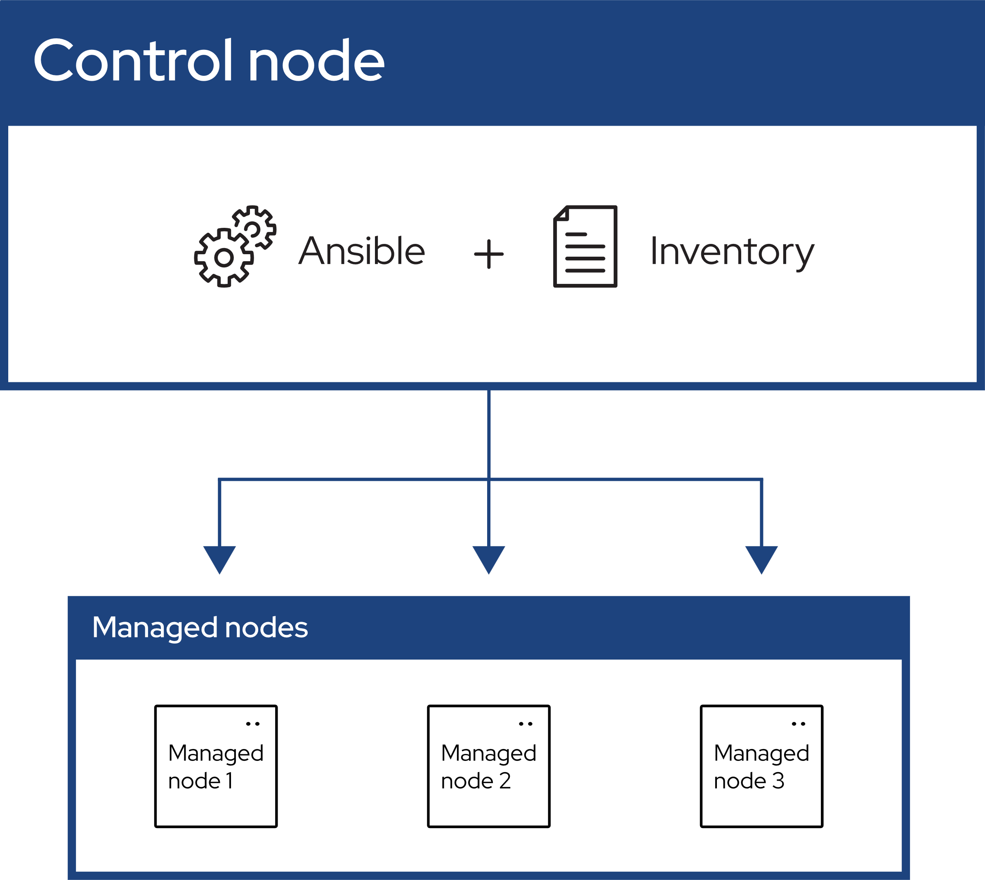
Ansible Concepts
Control Node Role
The control node is the central system where Ansible is installed and automation commands originate.
Managed Nodes Definition
Managed nodes are target systems controlled by Ansible, including Linux, Windows, and other operating systems.
Communication Protocols
Control node communicates with managed nodes using SSH for Unix-like systems and WinRM for Windows systems.
Agentless Automation Benefits
Ansible automates tasks without installing agents on managed nodes, simplifying configuration and improving security.
Notes:
In Ansible architecture, the control node is the system where Ansible is installed and from which automation commands are executed. It acts as the central orchestrator, managing the execution of playbooks and modules. Managed nodes are the target systems that Ansible controls, which can include Linux, Windows, or other operating systems. Communication between the control node and managed nodes is established via SSH for Unix-like systems and WinRM for Windows systems. This setup allows administrators to automate tasks across a heterogeneous environment without installing agents on each managed node, thereby simplifying configuration and enhancing security.

Slide 6
Ansible Concepts
Inventory
A list of managed nodes provided by one or more inventory sources . Your inventory can specify information specific to each node, like IP address. It is also used for assigning groups, that both allow for node selection in the Play and bulk variable assignment.
Playbooks
They contain Plays (which are the basic unit of Ansible execution). This is both an ‘execution concept’ and how we describe the files on which ansible-playbook operates.
Playbooks are written in YAML and are easy to read, write, share and understand. To learn more about playbooks, see Ansible playbooks.
Plays
The main context for Ansible execution, this playbook object maps managed nodes (hosts) to tasks. The Play contains variables, roles and an ordered lists of tasks and can be run repeatedly. It basically consists of an implicit loop over the mapped hosts and tasks and defines how to iterate over them.

Slide 7
Ansible Concepts
Roles
A limited distribution of reusable Ansible content (tasks, handlers, variables, plugins, templates and files) for use inside of a Play.
To use any Role resource, the Role itself must be imported into the Play.
Tasks
The definition of an ‘action’ to be applied to the managed host. You can execute a single task once with an ad hoc command using ansible or ansible-console (both create a virtual Play).
Handlers
A special form of a Task, that only executes when notified by a previous task which resulted in a ‘changed’ status.

Slide 8
Ansible Concepts
Modules
The code or binaries that Ansible copies to and executes on each managed node (when needed) to accomplish the action defined in each Task.
Each module has a particular use, from administering users on a specific type of database to managing VLAN interfaces on a specific type of network device.
You can invoke a single module with a task or invoke several different modules in a playbook. Ansible modules are grouped in collections. For an idea of how many collections Ansible includes, see the Collection Index.
Plugins
Pieces of code that expand Ansible’s core capabilities. Plugins can control how you connect to a managed node (connection plugins), manipulate data (filter plugins) and even control what is displayed in the console (callback plugins).
Collections
A format in which Ansible content is distributed that can contain playbooks, roles, modules, and plugins. You can install and use collections through Ansible Galaxy.
Collection resources can be used independently and discretely from each other.

Slide 9

Inventory Basics
Inventory File Types
Inventory files can be static using INI or YAML formats, or dynamic from cloud providers and scripts.
Host Grouping
Hosts are grouped logically into categories like web servers or database servers for targeted automation.
Dynamic Inventory Sources
Dynamic inventories use plugins or scripts to fetch host data from external sources such as AWS EC2.
Importance of Inventory Structure
Proper inventory organization ensures efficient automation across diverse environments and tasks.

Slide 10
Inventory Basics Image
Host Grouping
[control]
localhost ansible_connection=local
[target]
target1 ansible_host=172.31.30.82
ubuntu@Control:~$
Host Grouping
Ansible Variables
Ansible Variable

Slide 11

Writing Your First Playbook
Basics of Playbooks
Playbooks are written in YAML to define hosts and tasks for Ansible automation.
Task Execution Example
A simple playbook can ping all hosts to verify connectivity efficiently.
Advanced Playbook Features
Playbooks support variables, conditionals, loops, and roles to enhance modularity.
Effective Playbook Writing
Understanding sequencing, error handling, and idempotency ensures reliable automation.

Slide 12

Demo Plan
Static Inventory Creation
Users start by creating a static inventory file that lists the target hosts for automation tasks.
Writing a Basic Playbook
A simple YAML playbook using the ping module is written to test connectivity across hosts.
Executing the Playbook
The playbook is executed via the ansible-playbook command to verify task execution and results.
Concept Reinforcement
This demo reinforces key Ansible concepts like inventory management, playbook syntax, and CLI usage.

Slide 13
Demo SAMPLE
[control]
localhost ansible_connection=local
[target]
target1 ansible_host=172.31.30.82
ubuntu@Control:~$
Static Inventory
ubuntu@Control:~$ cat ansible_demo_2.yaml
---
- name: Demo to ping Servers ( Control and Target)
hosts: all
tasks:
- name: Ping All servers
ansible.builtin.ping:
...
ubuntu@Control:~$ ansible-playbook ansible_demo_2.yaml --syntax-check
playbook: ansible_demo_2.yaml
ubuntu@Control:~$ ansible-playbook ansible_demo_2.yaml
PLAY [Demo to ping Servers ( Control and Target)] ******************************************************************************************
TASK [Gathering Facts] *********************************************************************************************************************
ok: [localhost]
ok: [target1]
TASK [Ping All servers] ********************************************************************************************************************
ok: [localhost]
ok: [target1]
PLAY RECAP *********************************************************************************************************************************
localhost : ok=2 changed=0 unreachable=0 failed=0 skipped=0 rescued=0 ignored=0
target1 : ok=2 changed=0 unreachable=0 failed=0 skipped=0 rescued=0 ignored=0
Writing basic playbook
Executing Playbook

Slide 14
CLI Demo SAMPLE
ubuntu@Control:~$ ansible -m ping target
target1 | SUCCESS => {
"ansible_facts": {
"discovered_interpreter_python": "/usr/bin/python3"
},
"changed": false,
"ping": "pong"
}
ubuntu@Control:~$ ansible -m ping control
localhost | SUCCESS => {
"ansible_facts": {
"discovered_interpreter_python": "/usr/bin/python3"
},
"changed": false,
"ping": "pong"
}
ubuntu@Control:~$ ansible -m ping all
localhost | SUCCESS => {
"ansible_facts": {
"discovered_interpreter_python": "/usr/bin/python3"
},
"changed": false,
"ping": "pong"
}
target1 | SUCCESS => {
"ansible_facts": {
"discovered_interpreter_python": "/usr/bin/python3"
},
"changed": false,
"ping": "pong"
}
ubuntu@Control:~$

Slide 15

Quiz (Page 1 out of 2)
1. What is Ansible primarily used for?
A. Monitoring
B. Automation
C. Backup
D. Virtualization
2. Which language is used to write Ansible playbooks?
A. JSON
B. XML
C. YAML
D. Python
3. What is the default location of the Ansible configuration file?
A. /etc/ansible.cfg
B. ~/.ansible.cfg
C. /etc/ansible/ansible.cfg
D. ansible.cfg in current directory
4. Which Ansible module is used to ping a host?
A. ping_host
B. ansible_ping
C. ping
D. host_ping
5. What does Ansible use to connect to Linux hosts by default?
A. WinRM
B. SSH
C. Telnet
D. FTP3

Slide 16
1. What is an inventory file in Ansible?
A. A list of tasks
B. A list of variables
C. A list of managed hosts
D. A list of modules
2. Which command runs an Ansible playbook?
A. ansible-run
B. ansible-playbook
C. ansible-execute
D. ansible-task
3. What is the purpose of the gather_facts directive in a playbook?
A. To collect logs
B. To collect system information
C. To collect passwords
D. To collect playbook results
4. Which file format is commonly used for Ansible roles and variables?
A. .json
B. .yaml
C. .ini
D. .cfg
5. What does idempotency mean in Ansible?
A. Tasks run only once
B. Tasks always fail
C. Tasks produce the same result if run multiple times
D. Tasks are skipped randomly
Quiz (Page 2 out of 2)

Slide 17
Ansible Quiz – Beginner Level with Explanations
Question | Answer | Explanation
What is Ansible primarily used for? | B. Automation | Ansible is an open-source tool used for automating IT tasks like configuration management, application deployment, and orchestration. It helps reduce manual effort and ensures consistency across systems.
Which language is used to write Ansible playbooks? | C. YAML | Ansible playbooks are written in YAML (Yet Another Markup Language), which is human-readable and easy to learn. It allows you to define tasks, and roles in a structured format.
What is the default location of the Ansible configuration file? | C. /etc/ansible/ansible.cfg | Ansible checks for ansible.cfg in the current directory first, then in the user's home directory (~/.ansible.cfg), and finally in /etc/ansible/ansible.cfg. The closest file takes precedence.
Which Ansible module is used to ping a host? | C. ping | The ping module is used to test connectivity between the control node and managed nodes. It returns "pong" if the connection is successful.
What does Ansible use to connect to Linux hosts by default? | B. SSH | Ansible uses SSH to connect to Linux-based systems. This allows it to execute commands remotely without needing an agent on the target machine.
What is an inventory file in Ansible? | C. A list of managed hosts | The inventory file defines which hosts Ansible will manage. It can be static (INI/YAML format) or dynamic (e.g., pulling from AWS or other cloud providers).
Which command runs an Ansible playbook? | B. ansible-playbook | The ansible-playbook command is used to execute playbooks written in YAML. It reads the tasks and applies them to the specified hosts.
What is the purpose of the gather_facts directive in a playbook? | B. To collect system information | gather_facts: true enables Ansible to collect details about the target system (e.g., OS, memory, IP address) before running tasks. This data can be used in conditional logic or templating.
Which file format is commonly used for Ansible roles and variables? | B. .yaml | YAML is used for defining roles, variables, tasks, and playbooks in Ansible. It’s preferred for its readability and simplicity
What does idempotency mean in Ansible? | C. Tasks produce the same result if run multiple times | Idempotency ensures that running a playbook multiple times doesn’t change the system state unnecessarily. For example, installing a package that’s already installed won’t reinstall it

Slide 18
Mini Challenge: Try It Yourself
Write a playbook to install Apache on an Ubuntu server – Hint: you may use ansible.builtin.apt Module, Package name: apache2
Ensure the service is started and enabled – Hint: You may use ansible.builtin.service module, Service name: httpd for RHEL/ CentOS/ Fedora and apache2 for Debian / ubuntu OS
Test it on your lab environment and share results

Slide 19

What’s Next?
Discuss Ansible Architecture and Design using below
Ansible Configuration
Ansible Inventories
Ansible Modules
Notes:
In the next module, learners will delve deeper into Ansible's core components, including tasks, modules, and roles. They will explore how to structure playbooks for reusability, implement conditionals and loops, and manage variables effectively. This progression builds on the foundational knowledge from Module 1, preparing learners to tackle more complex automation scenarios. By mastering these elements, users can create scalable and maintainable automation workflows that align with best practices in IT operations.

